Slide 1


AI-Driven Fertility Risk Assessment and Cost-Effective ART Recommendation System and Concerned Ethics
24AIM112 Molecular biology and basic cellular physiology
24AIM115 Ethics, innovative research, businesses & IPR
TEAM MEMBERS:
K. Varshitha - CB.AI.U4AIM24122
Nikitha Sree TY - CB.AI.U4AIM24132
R. Ashwika - CB.AI.U4AIM24138
V. Sevita Naidu - CB.AI.U4AIM24150

Slide 2
Introduction
The advancement of artificial intelligence (AI) over the years has brought significant progress in various fields, including clinical applications.
One area where AI has proven to be particularly impactful is in fertility treatment prediction and management.
Infertility affects millions of people.
Infertility is a global concern caused by medical, genetic, and environmental factors.
One in every six people of reproductive age worldwide experience infertility.
For those struggling to conceive naturally, assisted reproductive technology (ART) offers a sense of hope.
ART involves various techniques like in-vitro fertilization (IVF), intracytoplasmic sperm injection (ICSI), gamete intrafallopian transfer (GIFT) etc.,
2

Slide 3
PROBLEM STATEMENT
Assisted reproductive technologies (ARTs) like IVF and ICSI offer hope to couples facing infertility, but their success rates vary. A key challenge is the lack of personalized, cost-effective treatment plans. This study uses machine learning to analyze the male and female fertility data to create a predictive model. By suggesting ART techniques to individual patients, we aim to improve success rates, reduce costs, and make fertility treatments more accessible and effective.

Slide 4
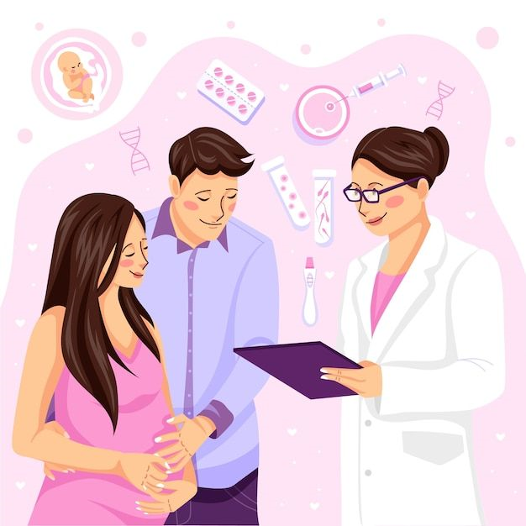
OBJECTIVE
Our aim is to use machine learning to predict fertility treatments based on detailed male and female fertility analysis.
The goal is to create a predictive model that can guide clinics in fertility treatment plans as well as the infertility couple according to their needs.
Ultimately, the aim is to boost the chances of success for couples undergoing Fertility treatments.
4

Slide 5
LITERATURE REVIEW
S.no | Title | Author | Methodology | Findings | Ethical concerns
1. | AI-Based Optimal Treatment Strategy Selection for Female Infertility for First and Subsequent IVF-ET Cycles (2023) | Renjie Wang, Wei Pan, Lean Yu, Xiaoming Zhang, Wulin Pan, Cheng Hu, Li Wen, Lei Jin, Shujie Liao | The study used a dynamic library of AI classification algorithms that analysed clinical data from 60,648 patients to predict outcomes of pregnancy based on various treatment strategies and patient characteristics like age and BMI. | The dynamic library of AI algorithms was able to analyse complex data and recommend most effective treatments. | Integration of AI in healthcare raises ethical concerns about the autonomy of clinicians, as more dependency on AI can affect their judgement and patient-centred approach.
2. | The Future Is Coming: Artificial Intelligence in the Treatment of Infertility Could Improve Assisted Reproductive Outcomes-The Values of Regulatory Frameworks (2022) | Sanja Medenica, Dusan Zivanovic, Ljubica Batkoska, Susanna Marinelli, Giuseppe Basile, Antonio Perino, Gaspare Cucinella, Giuseppe Gullo, Simona Zaami | The paper is a comprehensive review on the use of AI in reproductive medicine, such as predictive modeling, image analysis and decision making. The authors gather data on recent advancements, case studies, and outcomes of using AI tools in clinical settings. | AI has potential to enhance the ART outcomes by prediction of treatment success rates and embryo viability. AI systems can effectively analyse large datasets to identify patterns that can be generally overlooked. | Key ethical concerns are regarding patient autonomy, confidentiality of patient data and informed consent.
3. | Predicting male Infertility Using Artificial Neural Networks: A Review of the Literature (2024) | Vivian Schmeis Arroyo, Marco Iosa, Gabriella Antonucci, Daniela De Bartolo | The study is a review on machine learning models for predicting male infertility using PICO framework. Various studies from PubMed and ScienceDirect. | They identified 43 studies with a mean accuracy of 88% for machine models, especially ANN. | Ethical issues include data privacy and informed consent regarding the sensitive health information.

Slide 6
methodology
Collecting
Collecting the available fertility dataset for male and female
Creating
Creating a dataset for Factors affecting fertility in male and female
Combining
Combining the two datasets to create an output column, in the available dataset
Clustering
Clustering the Newly created dataset
Preprocessing
Preprocessing the dataset again
Developing
Developing a machine learning model to predict the most suitable fertility technique for the infertile couple
Improving
Improving the accuracy and effectiveness
Reviewing
Reviewing all the possible ethical consideration
Manual Recheck of New dataset
Recheck

Slide 7
Factors affecting infertility
Role of factors of infertility in female
Role of factors of infertility in male
Dataset Overview
Created dataset for female fertility
Code for creation of female dataset
Created dataset for male fertility
Code for creation of male dataset

Slide 8
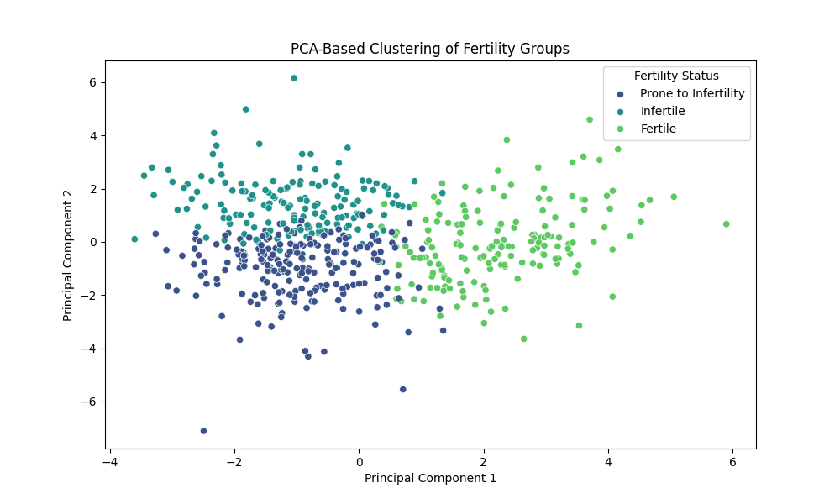
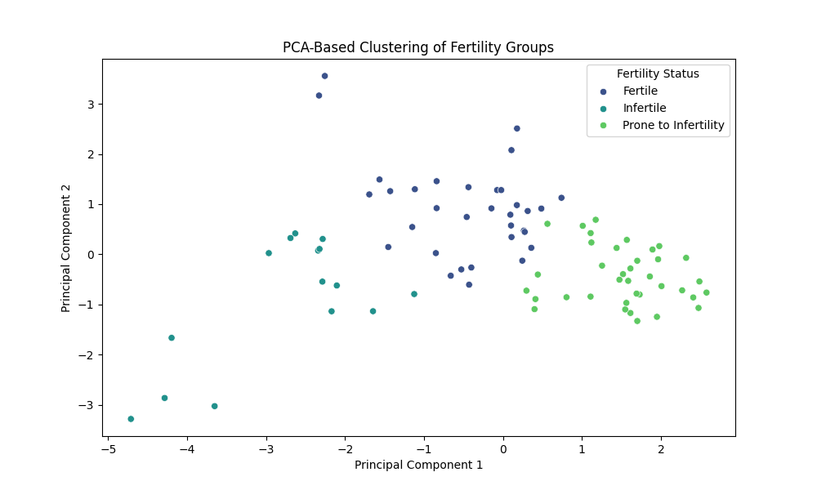
Clustering
Clustering for female dataset
Clustering for Male dataset

Slide 9
Ethical Consideration
Cost, Risk factors and Success rate should be explained to the couple.
Multiple eggs are retrieved, but not all are fertilized; the unused eggs should be disposed of properly.
Eggs collected for fertilization - few are used other which are unused must be disposed carefully to avoid moral or religious objections.
Clear the use, storage and disposal of gametes to avoid the disputes over gamete ownership. Donor data should be documented in cases of ai(artificial insemination)
Religious and cultural problems should be discussed with the couple if donor sperm is used. Rights of sperm donor should be explained.

Slide 10
CLINICAL TRIALS
“The Effect of Oral Vitamin E on Semen Parameters and IVF outcome” IRCT(2014020616506N1.)
Semen Parameters like volume, count, motility did not improve significantly and remained constant in Vitamin E group.
Worsened in case of placebo group. Vitamin E prevents the damage of sperm from getting worse.
Vitamin E acts as protecting agent without any significant changes.
2. “The Effect of Laser Acupuncture on Semen Parameters in Infertile Men
With Oligospermia:a Randomized Clinical Trial” IRCT(20200624027907n1) Parameters did not improve incase of control-group(placebo) Laser Acupuncture should a significant improvement in sperm quality

Slide 11
Ethical rights
1. RIGHT TO PARTICIPATION AND INFORMED CONSENT
Participants have right to know why need to provide their assistance/samples during the research. They have their choice to quit the participation at any time.(Right to Voluntariness)
2. RIGHT TO KNOW ABOUT RANDOMISATION AND BLINDING
Clinical trials generally use these process, which should be explained to the participants to have a broader idea.
3. RIGHTS TO ACCURATE & UNBIASED RESULTS
Binding method may be useful for the researchers but participants may lose motivation during time of results

Slide 12
patents
Embryo viability evaluation using AI/ML analysis of real-time video
https://patents.google.com/patent/US11455725B2/en
Automated evaluation of human embryos
https://patents.google.com/patent/WO2019068073A1/en

Slide 13
Innovation research
Suggesting a nutritious diet for the individuals of couples prone to infertility and for them to stay fertile.
Using AI techniques – to make decisions based on fertility techniques that makes it cost efficient.
Analysing the success rate of the fertility treatment

Slide 14
workflow
Data Collection
Creating the Dataset for factors
Combining the datasets
Clustering the datasets
Preprocessing the datasets
Modeling the dataset
Model Validation

Slide 15
Thank you

